Slide 1

The wisdom of crowds
http://compcogscisydney.org/psyc3211/
A/Prof Danielle Navarro
d.navarro@unsw.edu.au
compcogscisydney.org

Slide 2
Where are we?
L1: Connectionism
L2: Statistical learning
L3: Semantic networks
L4: Wisdom of crowds
L5: Cultural transmission
L6: Summary

Slide 3
Structure of the lecture
The core idea (Galton, Surowiecki)
Ranking tasks
Categorisation tasks
Combinatorial optimization tasks
Application to forensic science

Slide 4
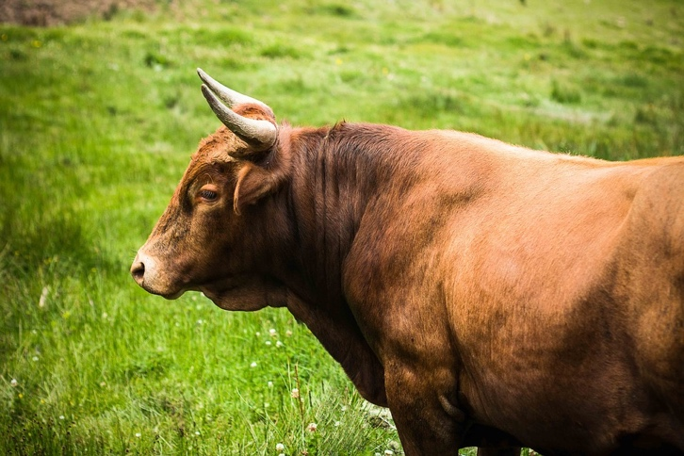
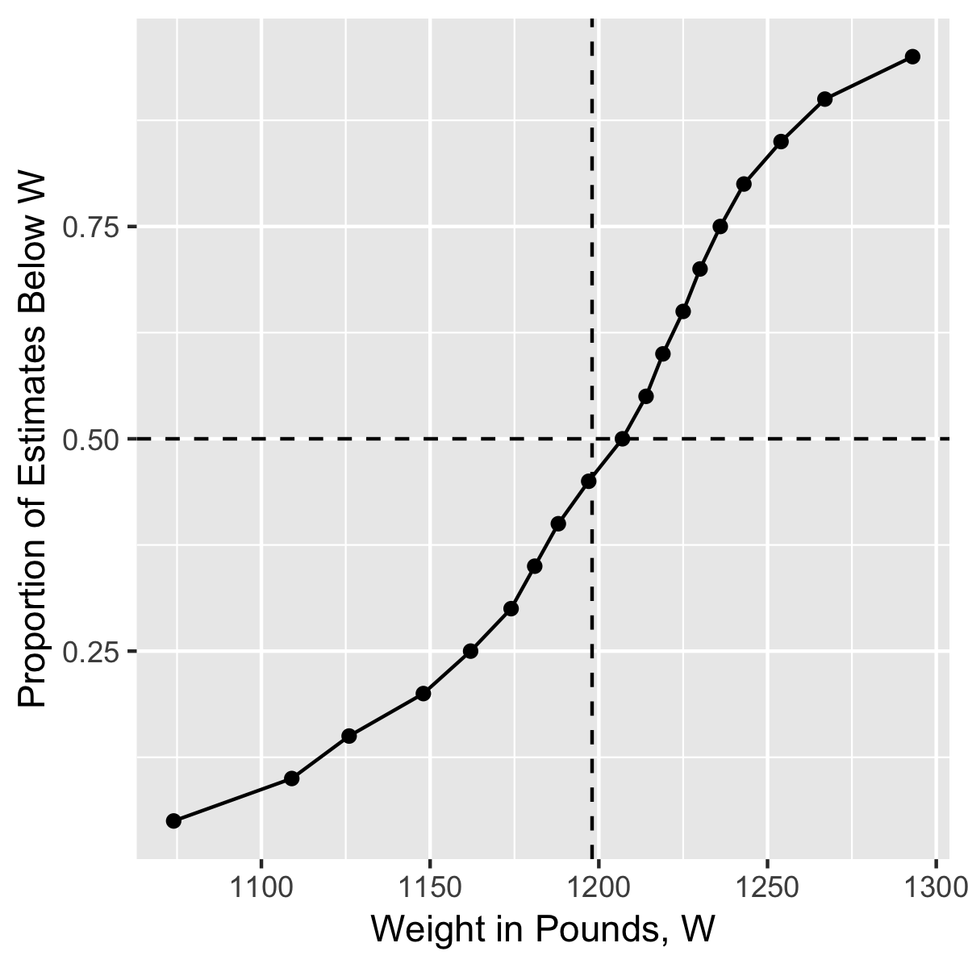
Vox populi
(Galton 1907)
True = 1198
Median = 1207

Slide 5
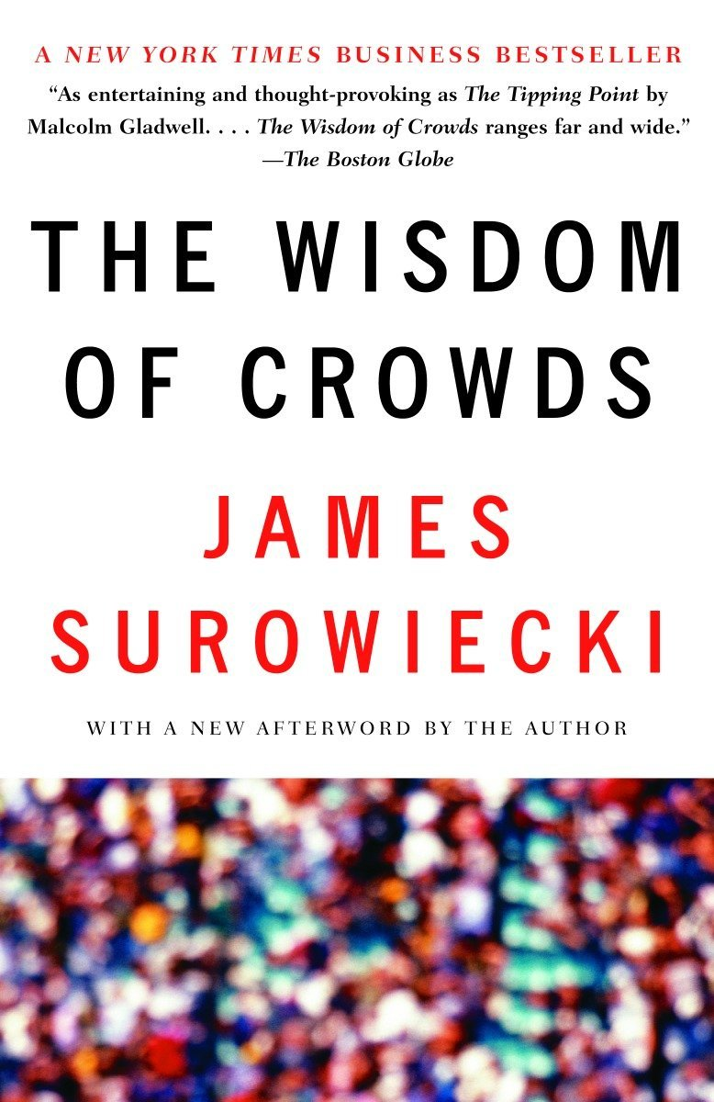
The wisdom of crowds
(Surowiecki 2004)
Criterion | Description
Diversity | Each person should have their own personal knowledge to rely on
Independence | Each person should form this opinion without any information about the opinions of others
Decentralization | Each person should be able to draw on different sources to form their opinion
Aggregation | There should be a sensible mechanism for combining the different opinions

Slide 6
Ranking tasks

Slide 7
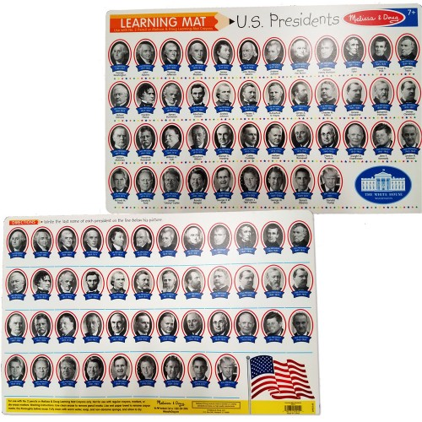
https://www.educationaltoysplanet.com/presidents-write-on-learning-placemat.html

Slide 8
Ranking tasks
(Steyvers et al 2009; Lee et al 2012)
George Washington
John Adams
Thomas Jefferson
James Monroe
Andrew Jackson
Theodore Roosevelt
Harry Truman
Dwight Eisenhower
Use a drag-and-drop interface to sort US presidents into chronological order
Variety of problems: books, city population, country landmass, country population, hardness, holidays, movies, US presidents, rivers, US states locations, superbowl, US constitution ten amendments, Bible ten commandments

Slide 9
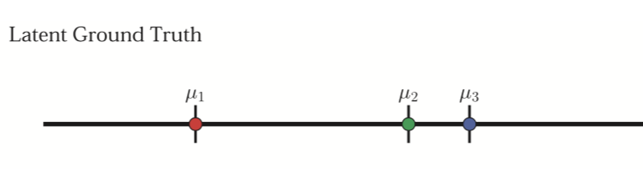
Ranking tasks
(Steyvers et al 2009; Lee et al 2012)
We assume the existence of a “latent ground truth” … needs to be estimated statistically from responses
These items are close together and are easy to mix up (e.g., Monroe & Jackson)
This item is very distant from the others, so it’s easy to get correct (e.g., George Washington as 1st US president)

Slide 10
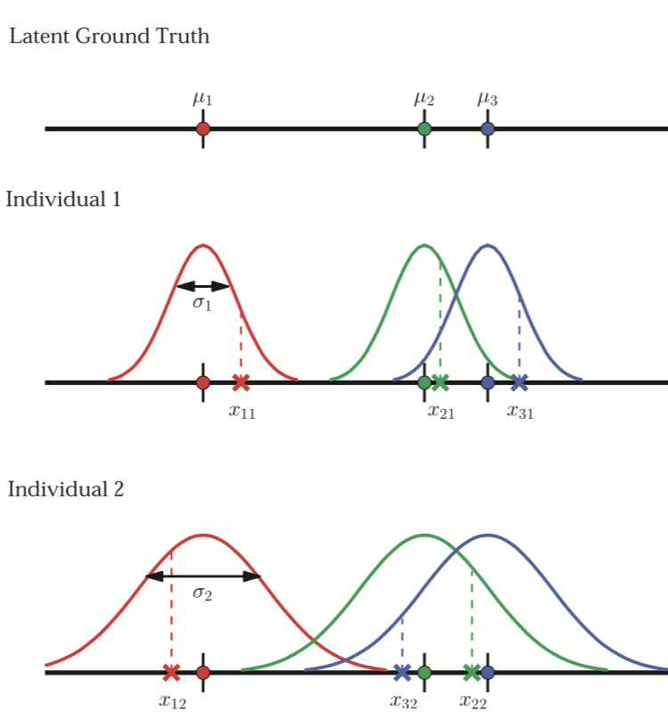
Ranking tasks
(Steyvers et al 2009; Lee et al 2012)
Some people have good knowledge of this (low noise)
Other people have poor knowledge of this (high noise)

Slide 11
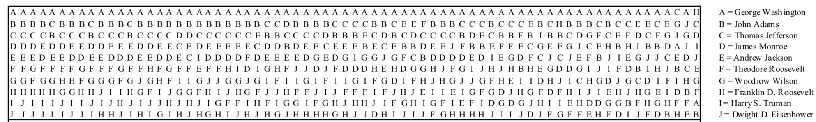
Ranking tasks
(Steyvers et al 2009; Lee et al 2012)
One person gets the exact ordering!
Almost everyone gets Washington correct
Few people know where to place Monroe
Data from all 78 subjects on the US presidents question
Variation in expertise of individuals
Variation in difficulty of items

Slide 12
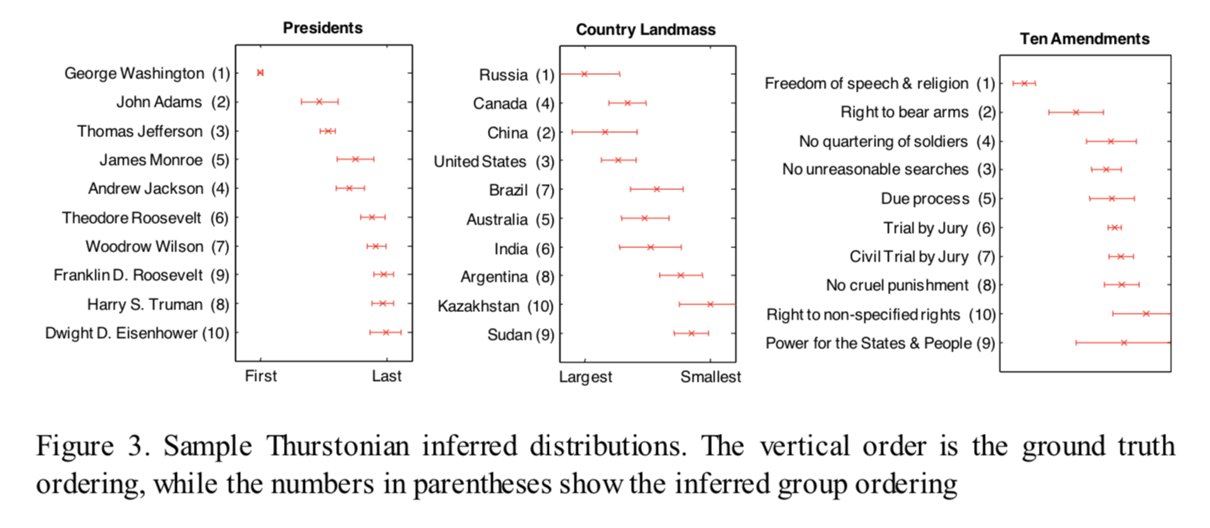
Ranking tasks
(Steyvers et al 2009; Lee et al 2012)

Slide 13
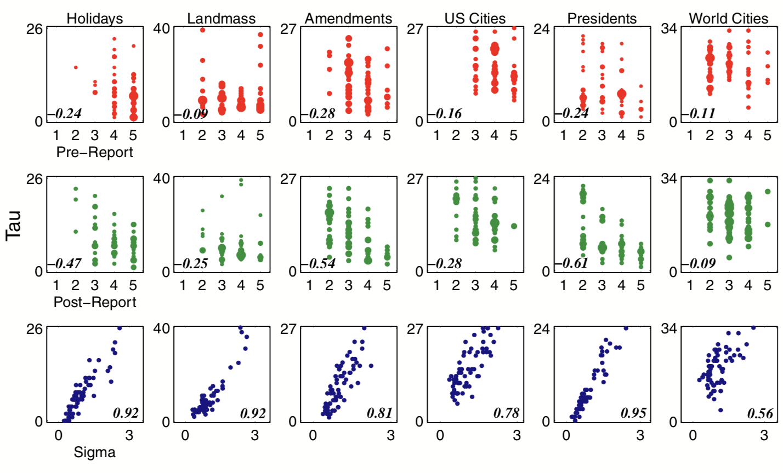
Ranking tasks
(Steyvers et al 2009; Lee et al 2012)
Tau: Agreement with the true ordering
Sigma: Expertise (noise) estimated by the model
Report: Judgment of own knowledge before (pre) and after (post) doing the task

Slide 14
A category learning example

Slide 15
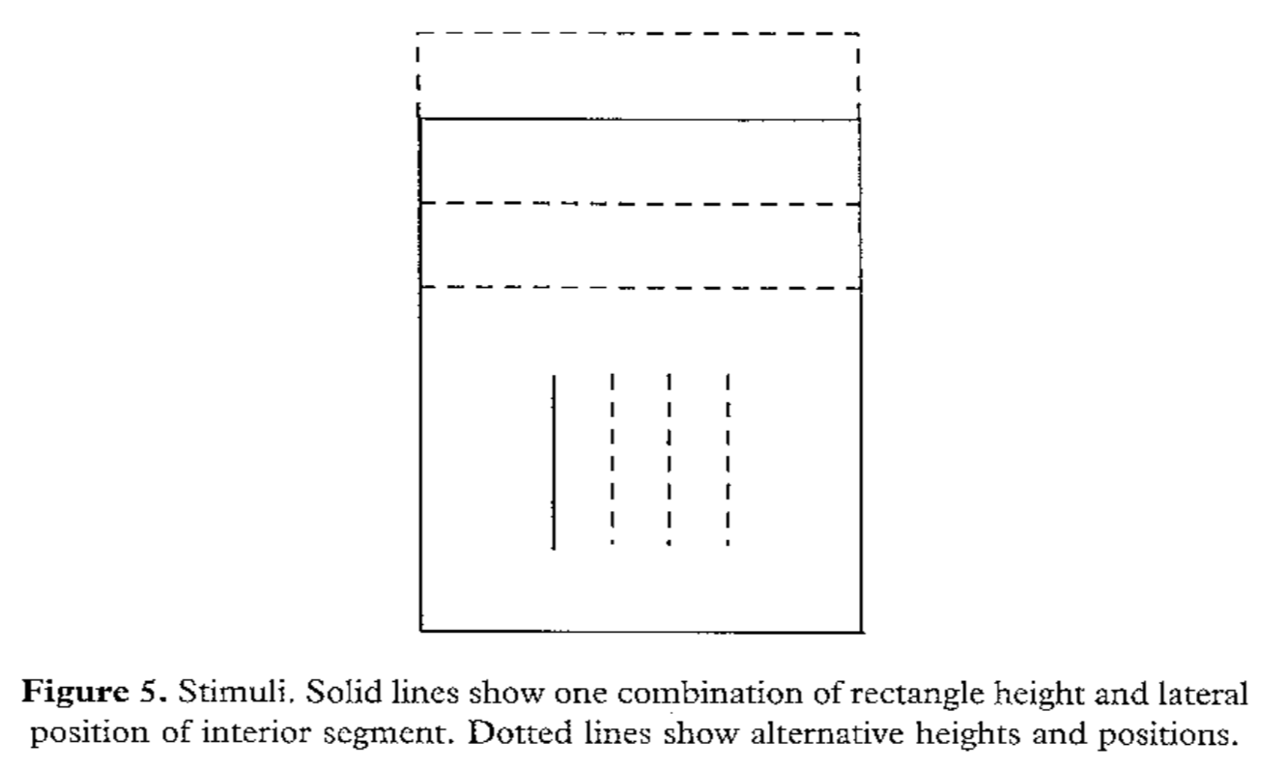
Category learning
(Kruschke 1993)
Stimuli are rectangles with different heights
With an internal line with different horizontal positions

Slide 16
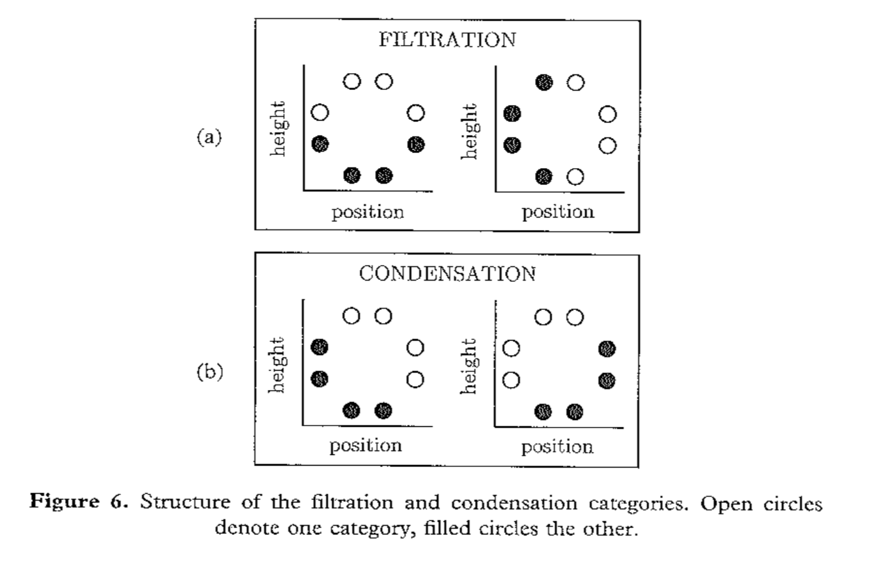
Category learning
(Kruschke 1993)
Black circles are “category A”
White circles are “category B”

Slide 17
Category learning
(Kruschke 1993)
Structure of a trial…
Participant makes a decision
Participant is then told what the correct answer was
A or B?
Repeat for 8 trial blocks/epochs
Each block/epoch presents each of the 8 items once

Slide 18
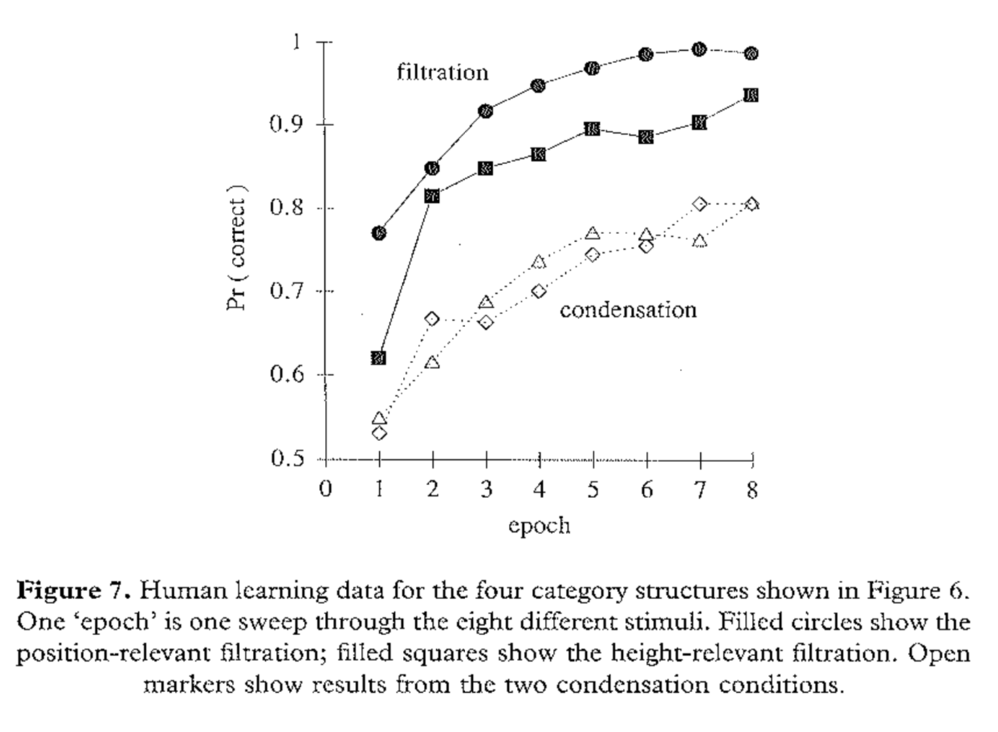
Category learning
(Kruschke 1993)
There’s a separate literature focusing on why these conditions are different from each other but let’s pick one condition and look at the individual differences…

Slide 19
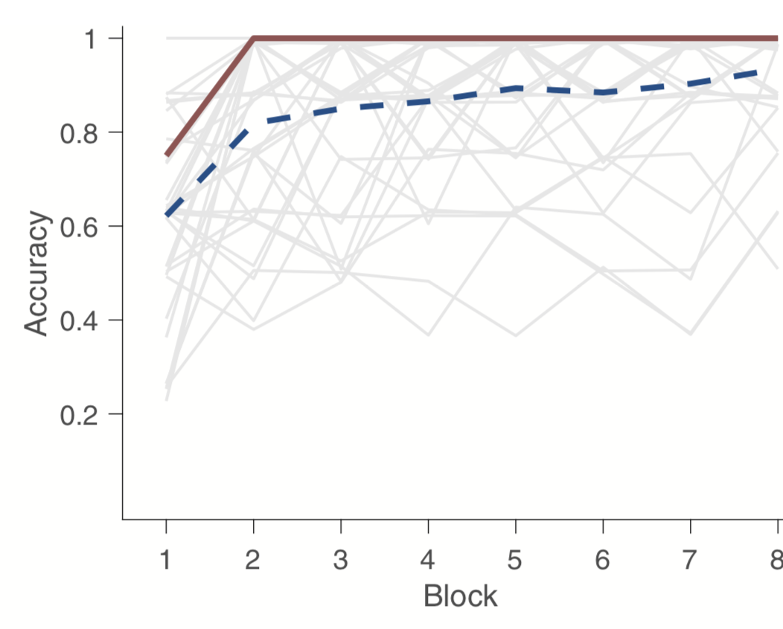
Category learning
(Danileiko & Lee 2017)
The red line is what would happen if you always chose with the majority on every trial
The blue line is the average accuracy of across people
Each grey line is the classification accuracy of one person over time

Slide 20
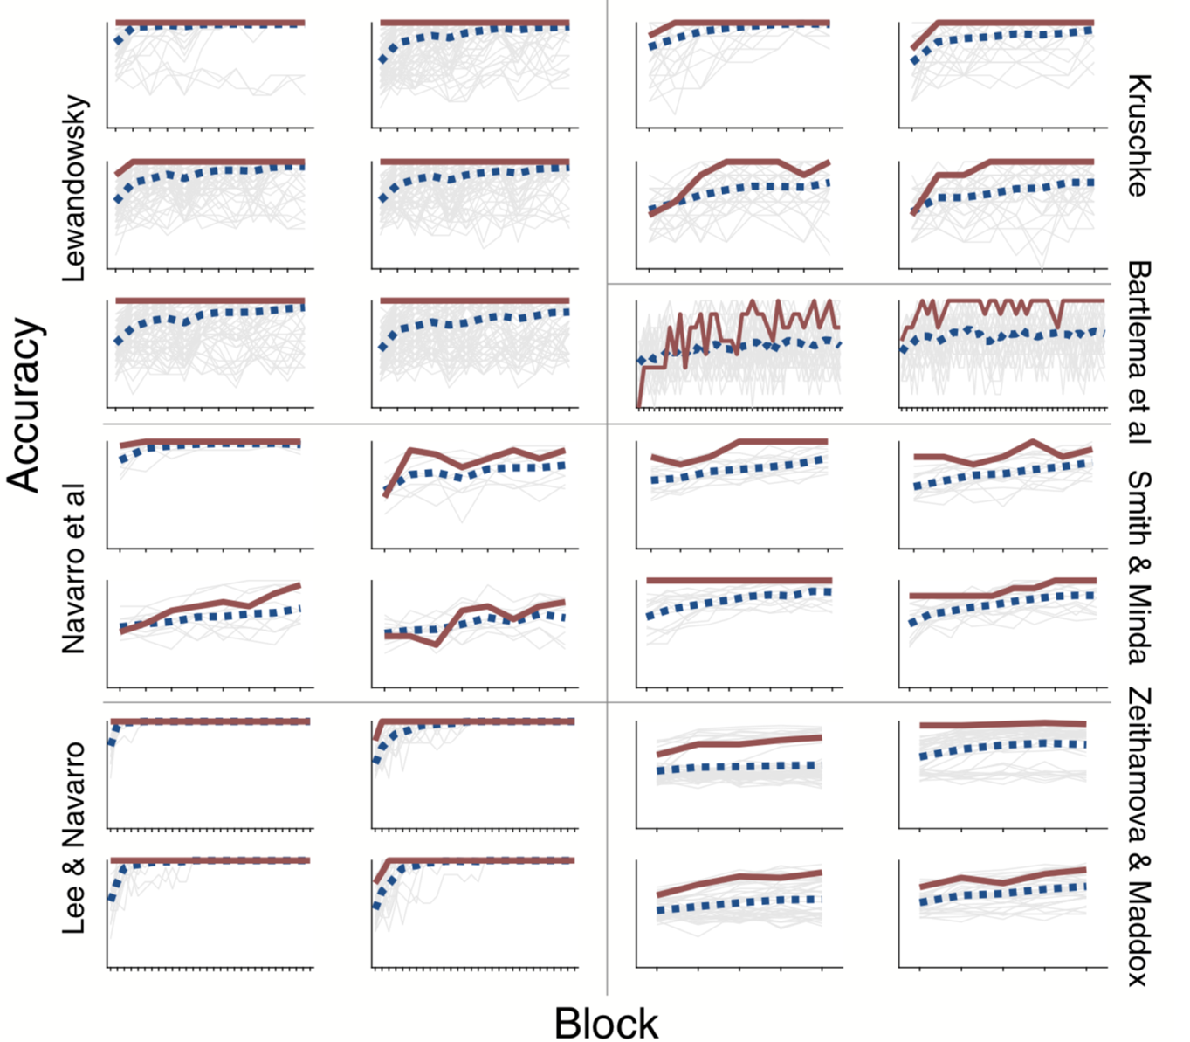
Category learning
(Danileiko & Lee 2017)
Here’s the same thing for 28 data sets
Mostly good, but there are some cases where it fails

Slide 21
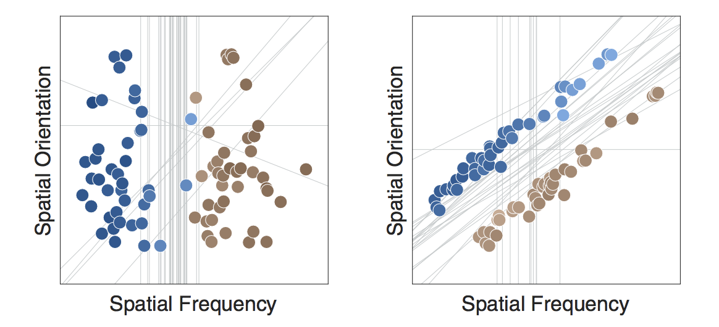
Category learning
(Danileiko & Lee 2017)
Problem? How do we generalize from crowd knowledge????
Solution: Instead of aggregating at the level of each response, estimate the categorization rule each person was applying, and average* those
*sort of

Slide 22
Complications on the wisdom of crowds phenomenon?

Slide 23
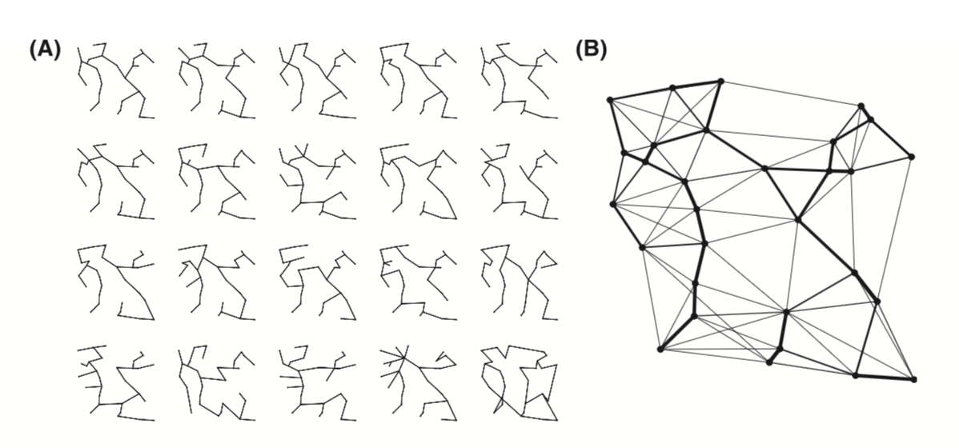
Minimum spanning trees
(Yi et al 2012)
The solution that maximises overall agreement* with individual choices is closer to optimal than any person’s solution
Individual solutions to the minimum spanning tree problem
*details omitted

Slide 24
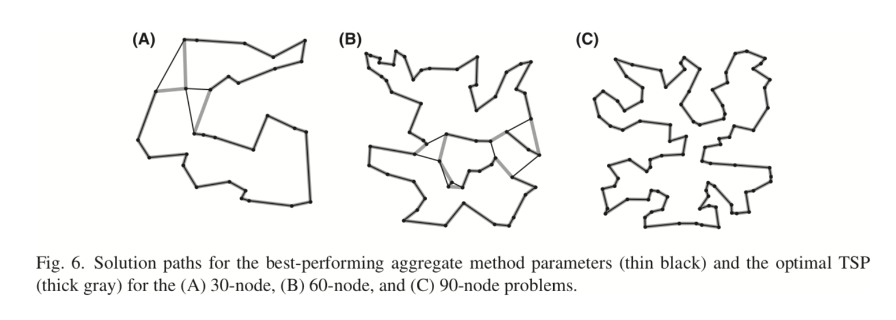
Travelling salesperson problem
(Yi et al 2012)
Same thing for the TSP!

Slide 25
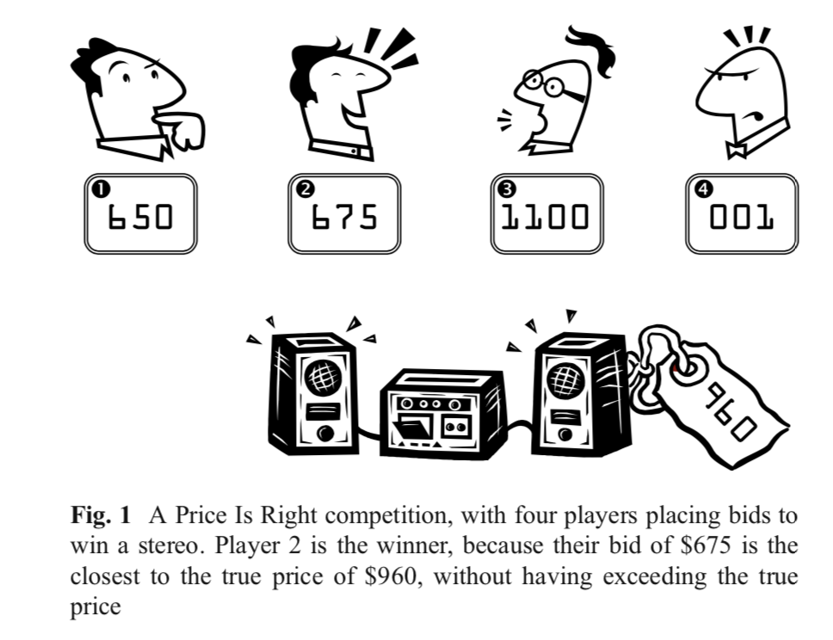
“The Price is Right”
(Lee et al 2010)

Slide 26
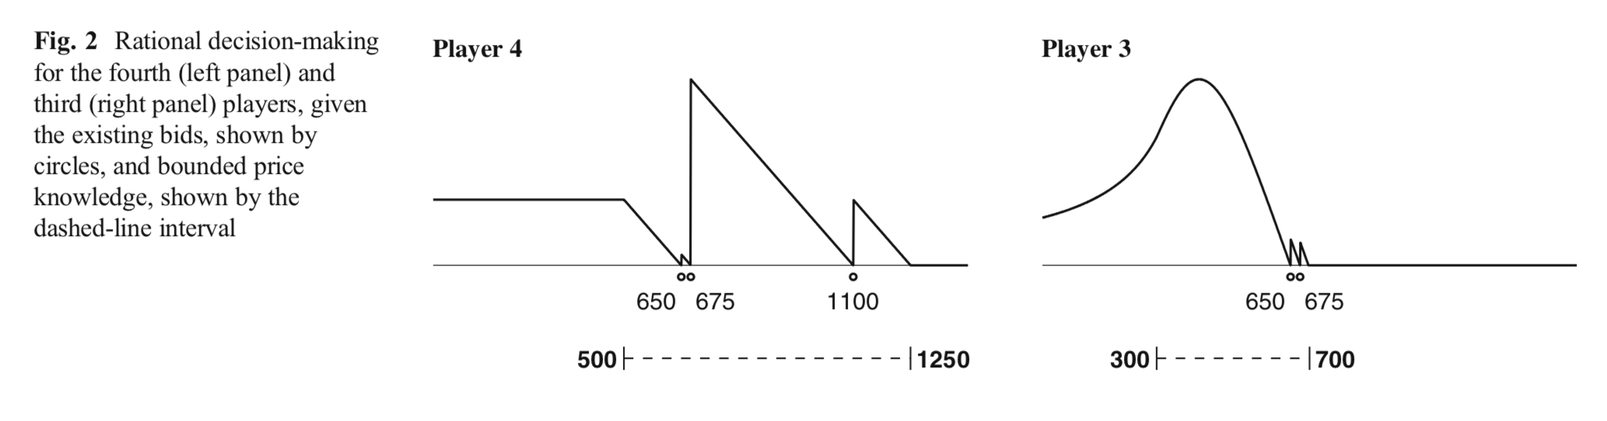
“The Price is Right”
(Lee et al 2010)
This is tricky because participants have a motivation not to give their best guess
A strategic bid from Player 3 depends on what Players 1 an 2 did, AND what they think Player 4 will do… so this is messy, socially-rich competitive environment!

Slide 27
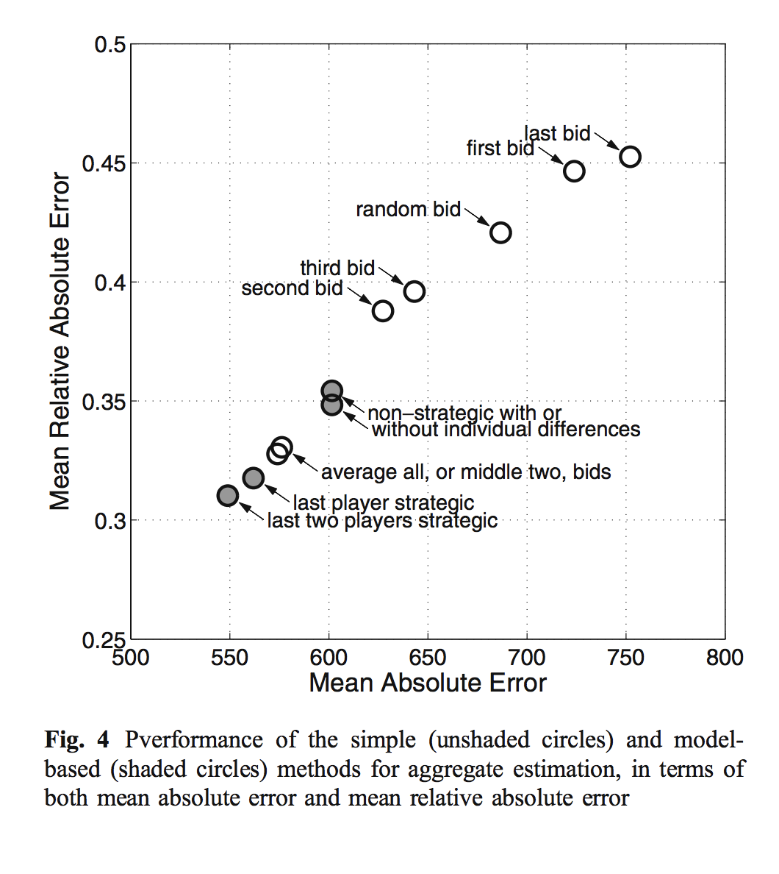
“The Price is Right”
(Lee et al 2010)
Again we see wisdom of crowds, but the effect is strongest when aggregation is done using a cognitive model that assumes the last two players are betting strategically!

Slide 28
A forensic science application

Slide 29
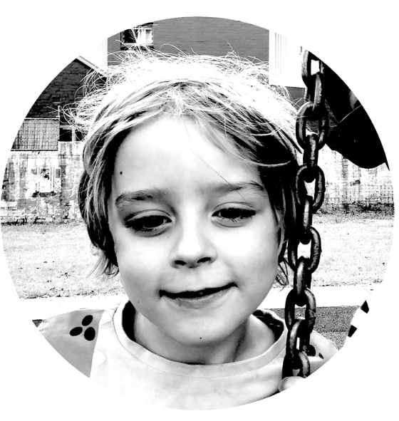
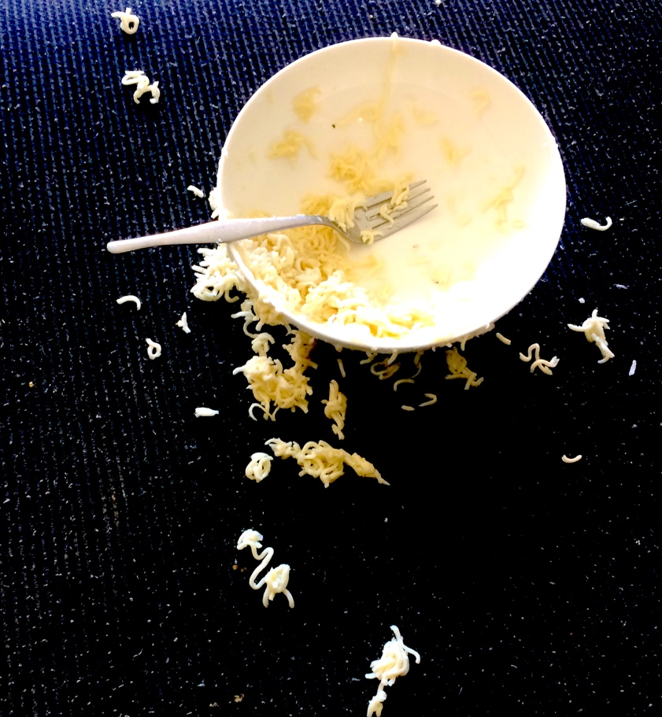
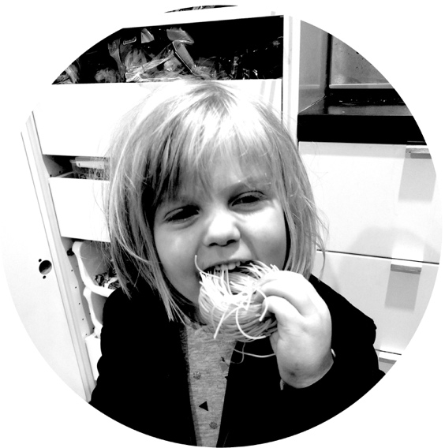
A crime has been committed
We have suspects

Slide 30
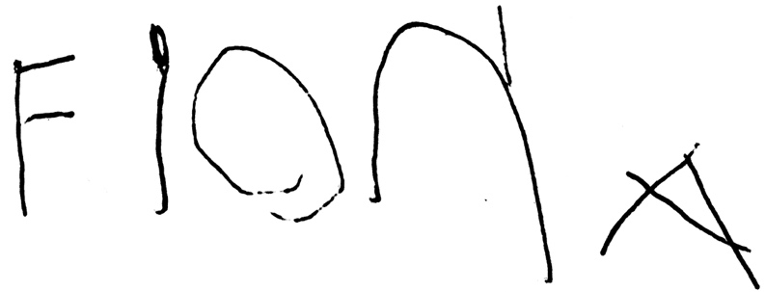

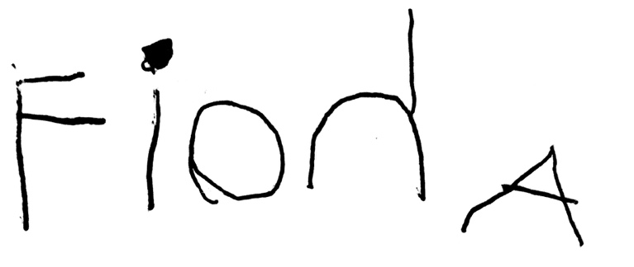
The police have a sample of handwriting from one of our suspects
A note is found near the crime scene

Slide 31
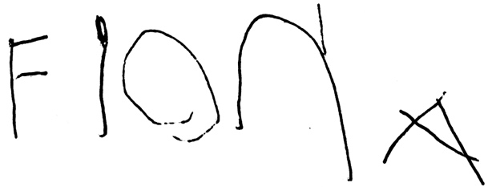

A variety of questions
The process problem: were these written in the same way? (e.g., disguising one’s handwriting)
The authorship problem: were these written by same person?
The feature match problem: what are the relevant features, and do the samples match?
Specific case: how good are people at evaluating whether a feature match is informative? Do we know which features in handwriting are common and which are rare?

Slide 32
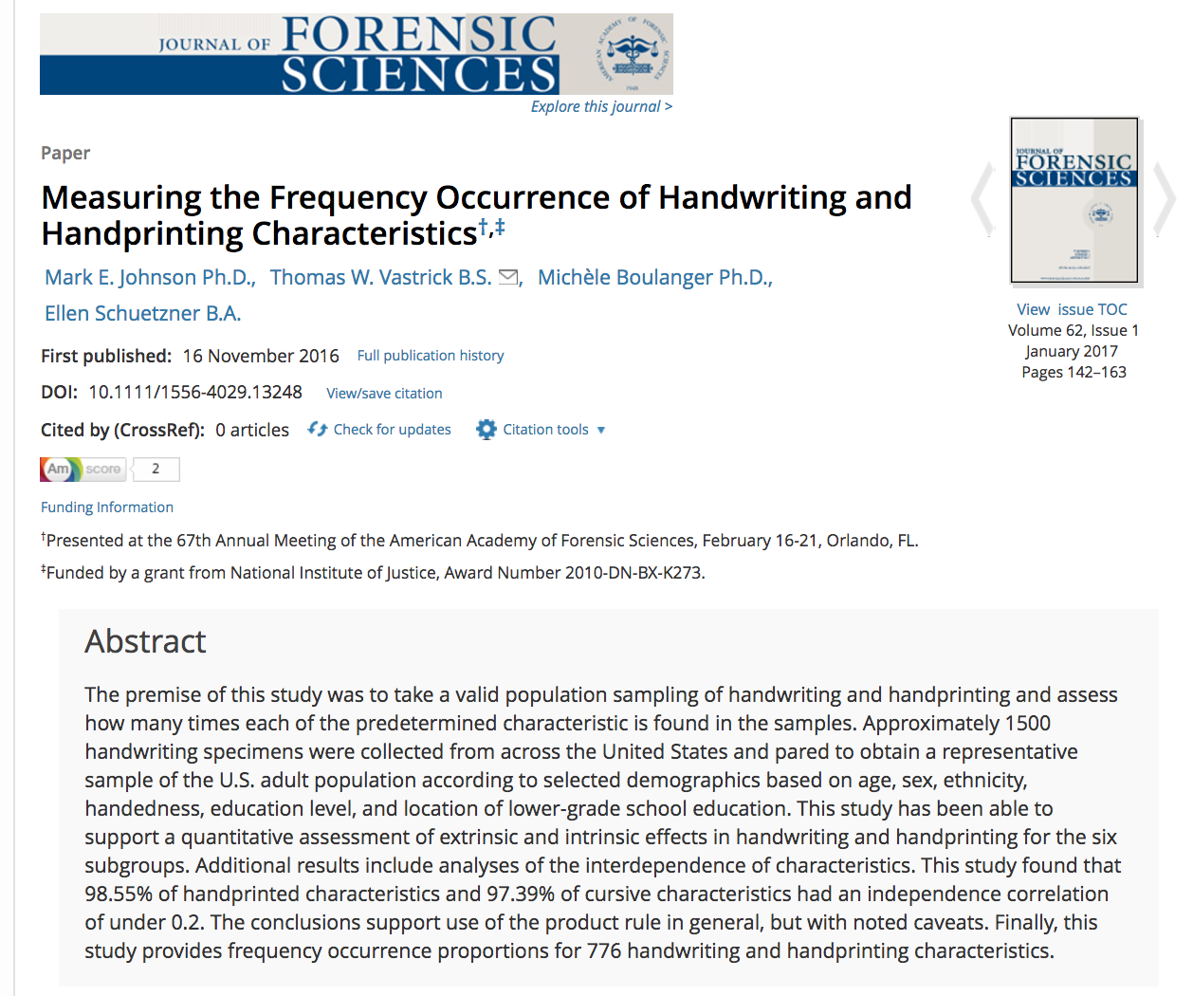
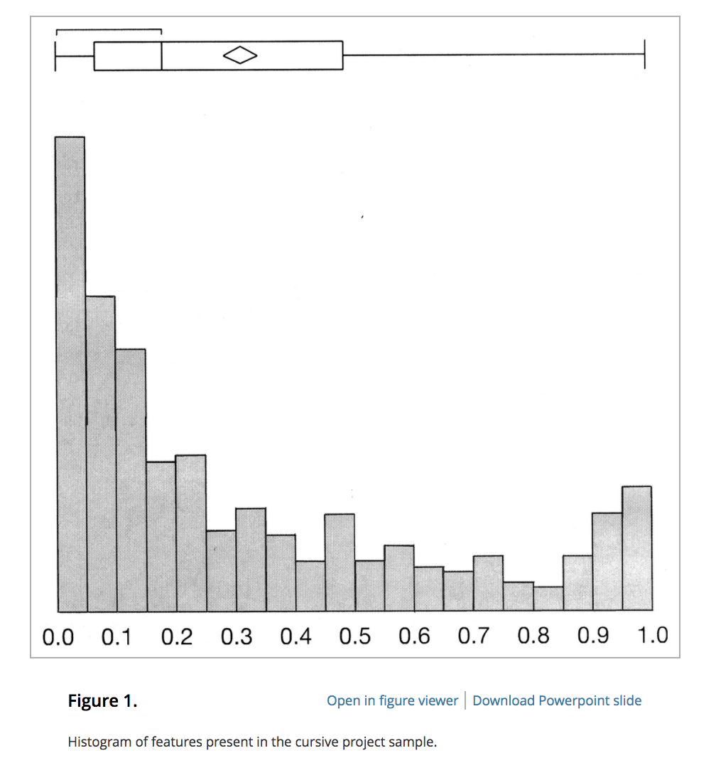
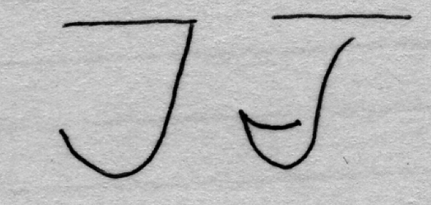
Handwriting features vary a lot in terms of their prevalence
Johnson et al (2016)

Slide 33
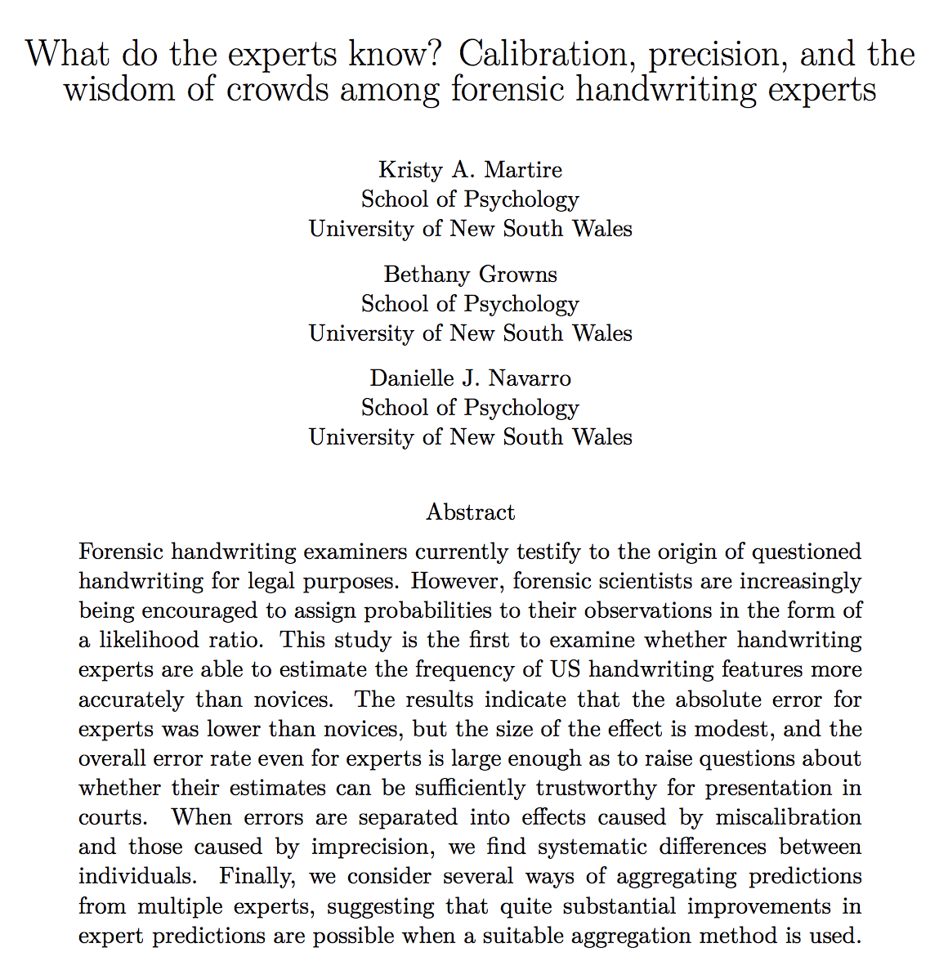
Looked at people’s accuracy for a variety of handwriting features

Slide 34
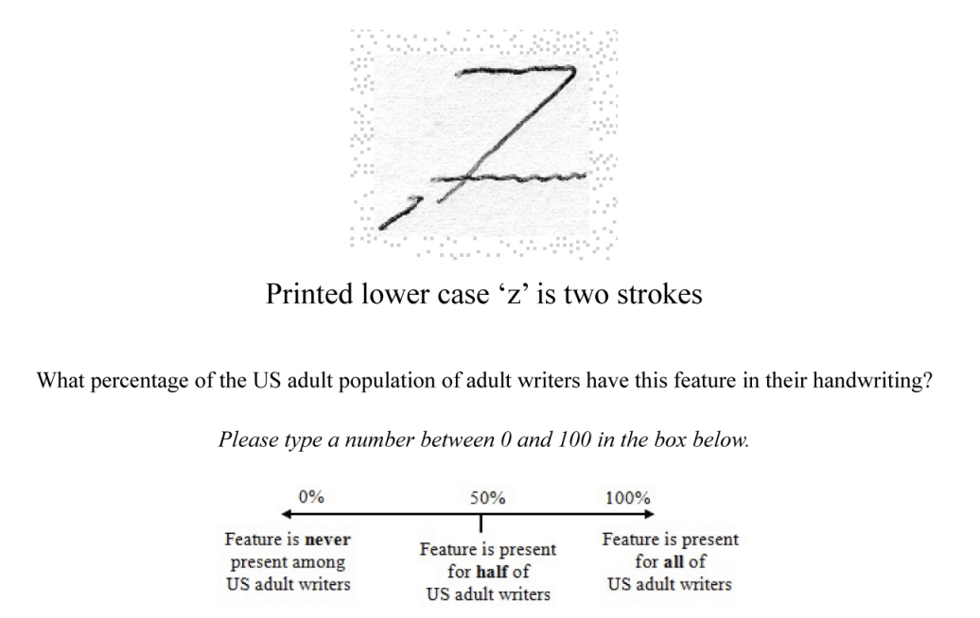
Forensic document examination
(Martire et al, in press)

Slide 35
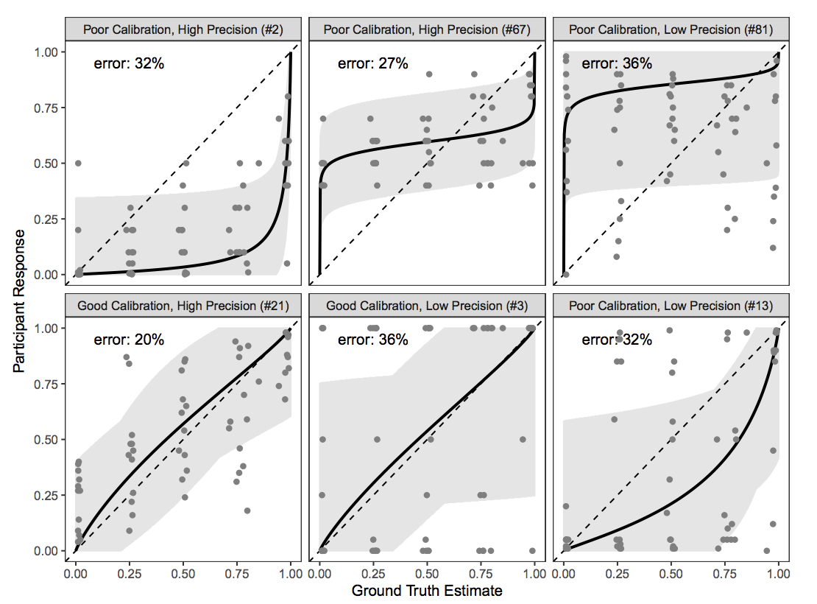
Forensic document examination
(Martire et al, in press)
Individual (both novices and experts) do know something about this, but judgments are noisy and there’s a lot of variability in how much people know

Slide 36
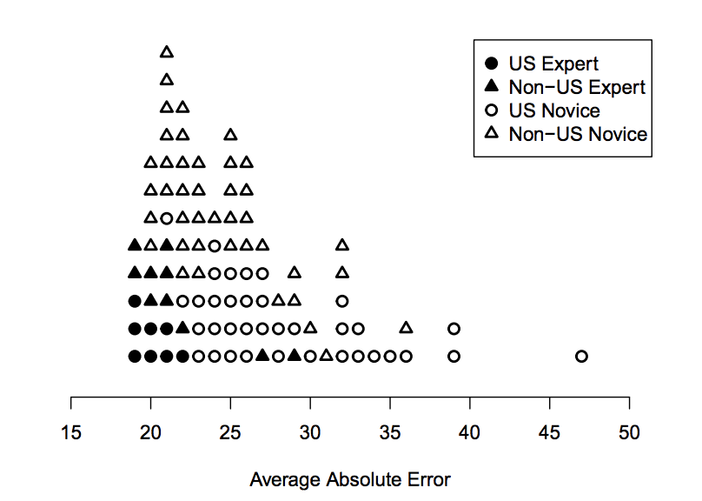
Forensic document examination
(Martire et al, in press)
individuals
crowd

Slide 37
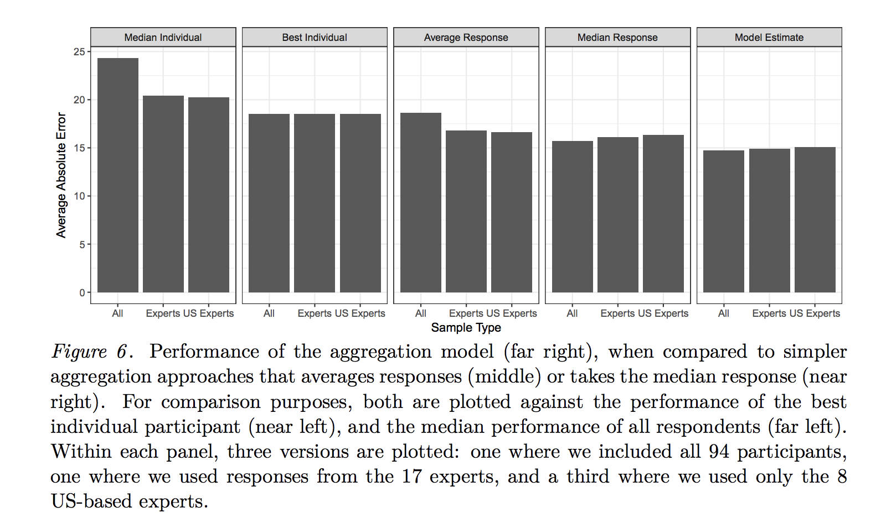
Forensic document examination
(Martire et al, in press)
Some aggregation methods work better than others…

Slide 38
Thanks

